Slide 1
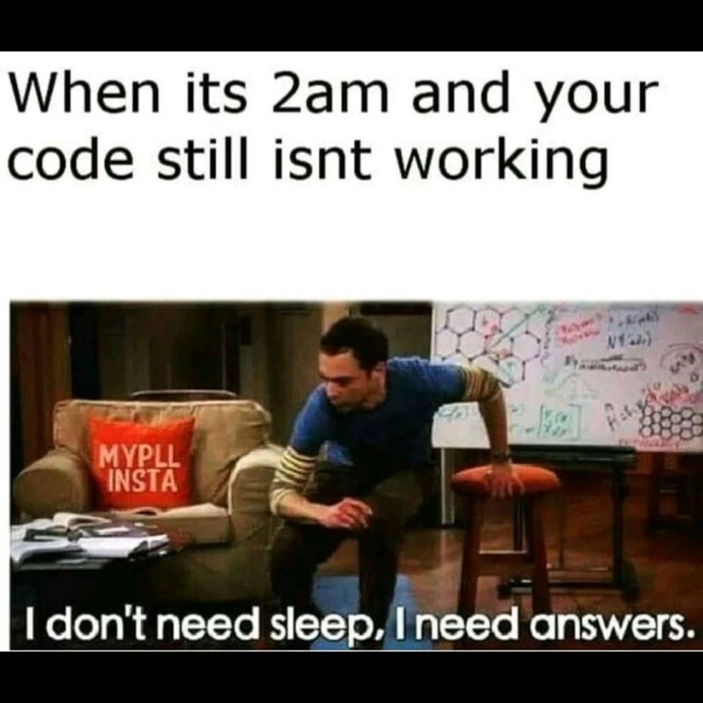

Slide 2
Clean Code
CS2308
Gentry Atkinson

Slide 3
Mathematical Foundation
“Programmers create problems for themselves when they write code solely to satisfy a compiler or interpreter.”
-Robert C. Martin, Clean Code

Slide 4
Programs Exists in 3 Languages
Concept
(Algorithm)
Implementation
(Code)
Run-time Behavior
(Machine Language)
Design
Compilation

Slide 5
Writing Clean Code
Preserve and expose the relationship between the concept, the code, and the program.
A reader should be able to look at 2 parts of your program and guess the 3rd.
Comments connect the concept to the program.
Good code style connects the program to the run-time behavior.
Write comments first.

Slide 6
Questions or Comments?

